Slide 1
W205: Increasing AGM Brand Awareness
Summer 2022
Annie Cui, Emily Zhou, Shuo Wang

Slide 2
Problem Statement
How can we partner with BART to expand AGM's brand awareness transbay?
Notes:
Annie Cui
As a team, we decided that the problem we want to solve is how to increase Acme Gourmet Meals brand awareness beyond the local Berkeley neighborhood. We will consider delivery system platform and investigate how to hone in on this aspect to increase growth.

Slide 3
Solution Approach
Identify
Identify top customers in the Bay Area (outside of Berkeley)
Calculate
Calculate nearest BART station to those customers
Deploy
Deploy pickup/delivery posts near those BART stations
Notes:
Annie Cui
Our proposed approach is to identify AGM's "top" customers outside of Berkeley and see where the highest count are located. Then calculate where these top customers are in respect to Bart stations. Then Deploy/launch AGM pickup and delivery posts at stations based on these top customers' locations.

Slide 4
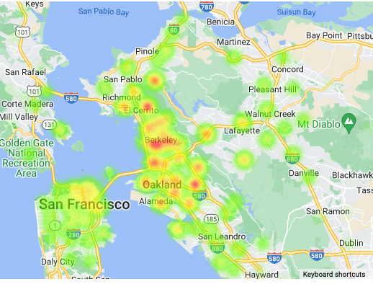
Berkeley Store - Heat Map
Intensity as the number of customers in each zip code
Notes:
Emily
Our goal with looking at heat maps is to identify 3 BART stations to pilot the delivery pick-up posts.
We want this to be successful, so we’ll choose BART stations in zip codes where we’ve established customer bases already.
To identify our top customers in each zip code, we looked at two approaches:
The zip codes with the highest number of customers
The zip codes with the highest amount of sales
This figure is showing the first approach, where we’re looking at a heat map of where our customers are. We can see that outside of Berkeley, there are a few other hotspots where we have lots of customers.

Slide 5
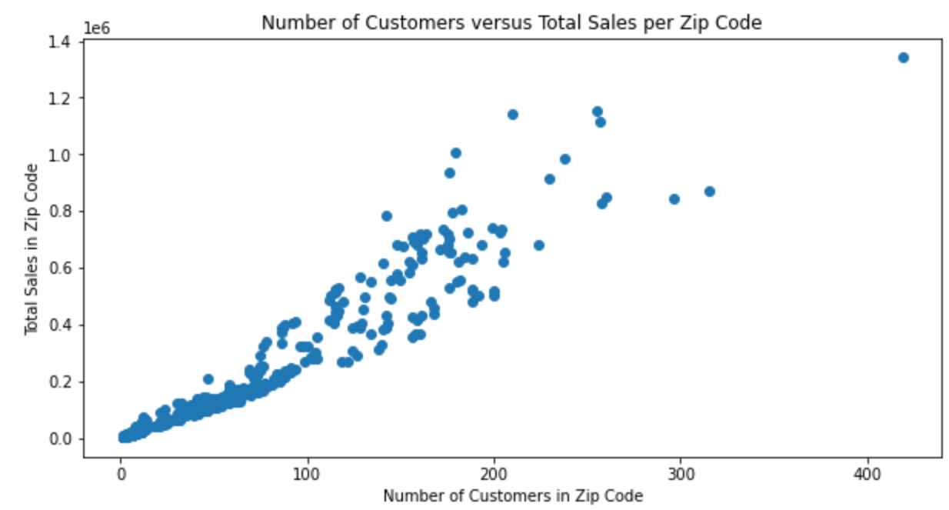
Notes:
Emily
Another approach we took was to look at zip codes where we had the most sales. This would require joining a sales table with the customers table, so before doing that, we assessed a hypothesis that maybe the zip codes with lots of customers were the same ones with lots of sales.
You can see in this scatterplot that there’s a positive correlation between total dollar sales and number of customers for each zip code.
To save on SQL joining and compute costs, we’ll go ahead with using the number of unique customers as the deciding factor for which zip codes to focus on piloting BART pick-ups at.

Slide 6
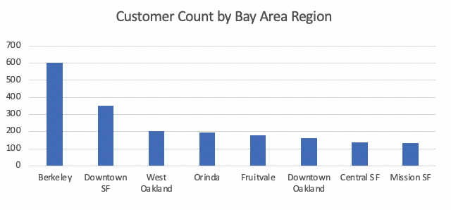
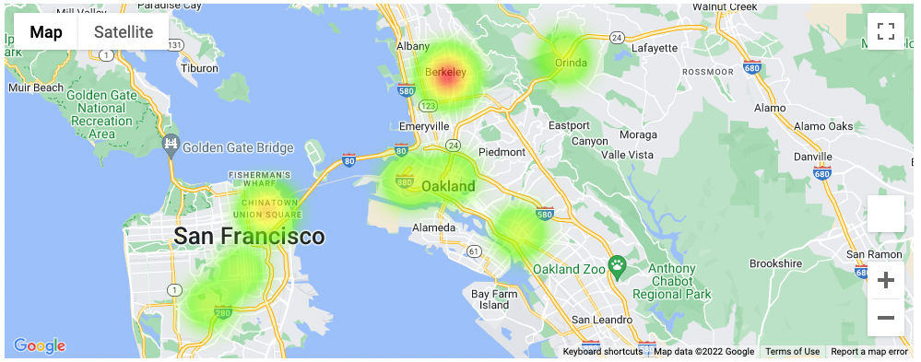
Identify top customers
Heat Map
Use AGM sales data to query for top customers and their locations
Notes:
Emily
Now, even though Berkeley has a high number of customers, we’ll exclude it from consideration because we already have a storefront there.
Instead, we’re choosing the next 7 BART stations with the highest number of customers, based on the zip codes within 1 mile radius of that station.
In the bar chart, the x-axis shows the BART stations. We renamed Powell station here for familiarity, to Downtown SF.
The BART station areas we chose to focus on are:
Downtown SF
West Oakland
Orinda
Fruitvale
Mission SF
Other top-count station areas are already quite close to the ones I just mentioned -- the chosen ones will provide sufficient coverage for customers.

Slide 7
Calculate shortest distances
- ADD pickup locations to areas with HIGH customer traffic and BART stations
- Use graph database (Neo4J) to show shortest path to stations (from store to top 5 pick up stations)
Depart From | Arrive At | BART Travel Time | Avg. Drive Time*
Downtown Berkeley | Orinda | 17 Minutes | 22 – 45 Minutes
Downtown Berkeley | Fruitvale | 20 Minutes | 20 – 40 Minutes
Downtown Berkeley | West Oakland | 17 Minutes | 14 – 35 Minutes
Downtown Berkeley | Powell | 27 Minutes | 30 – 60 Minutes
Downtown Berkeley | 24th and Mission St. | 33 Minutes | 35 – 70 Minutes
* times calculated using Google Maps drive time on weekday afternoon at 5pm
Notes:
Annie
We will use NEO4j database to calculate the shortest distances from the Downtown Berkeley BART station to the top 5 customer location groups.
We are choosing to use downtown Berkeley as the home station because it is the closest to AGM's store
The table shows the BART travel times to each station and also a comparison of the average drive times to these locations.
All of the travel times except to West Oakland suggest that BART would be faster option than driving.

Slide 8
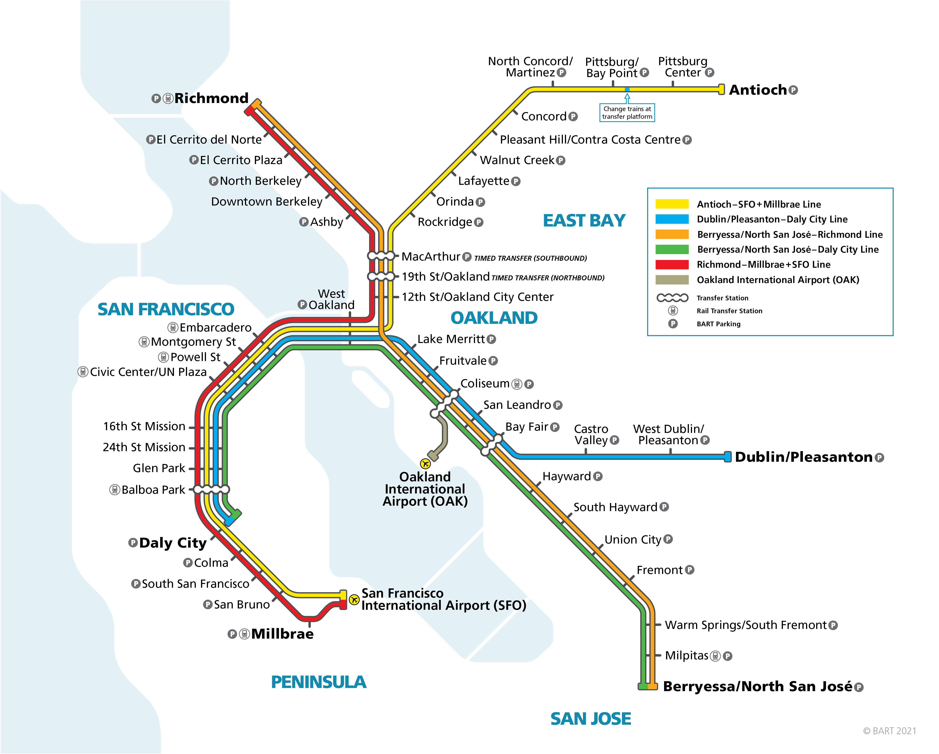

Deploy pickup/delivery posts
1. JOIN Bart data by locations to customer data
2. Group nearby zip codes to choose delivery posts
Notes:
Annie
After joining the top location groups of customer zips to the BART station zips, these are the pickup/delivery posts we are suggesting. These 5 stations are at the midpoint of the 5 locations with the highest customer counts.
The idea is to use the BART as a form of mass meal delivery, drop them off and store them in lockers near these stations for customers to pick up locally

Slide 9
Expected Results
Depart From | Arrive At | BART Cost | Drive Cost*
Downtown Berkeley | Orinda | $2.75 | $2.11
Downtown Berkeley | Fruitvale | $2.55 | $2.42
Downtown Berkeley | West Oakland | $2.25 | $1.58
Downtown Berkeley | Powell | $4.50 | $10.16
Downtown Berkeley | 24th and Mission St. | $4.65 | $10.87
1. Increased brand awareness
2. Decreased cost of delivery
3. Decrease time for delivery (during rush hour)
* Costs calculated based on 22mpg vehicle and $5.80/gallon gas price
Notes:
Annie
The results we hope to see from our proposal are Increased brand awareness transbay by:
1. using a new public form of delivery
2. having physical marketing in the form of our pickup posts
- Lowered delivery costs in further locations because bridge toll and gas prices
- Faster delivery times in rush hour and heavy traffic
- Reduced carbon footprint by pairing up with public transportation in our business model

Slide 10
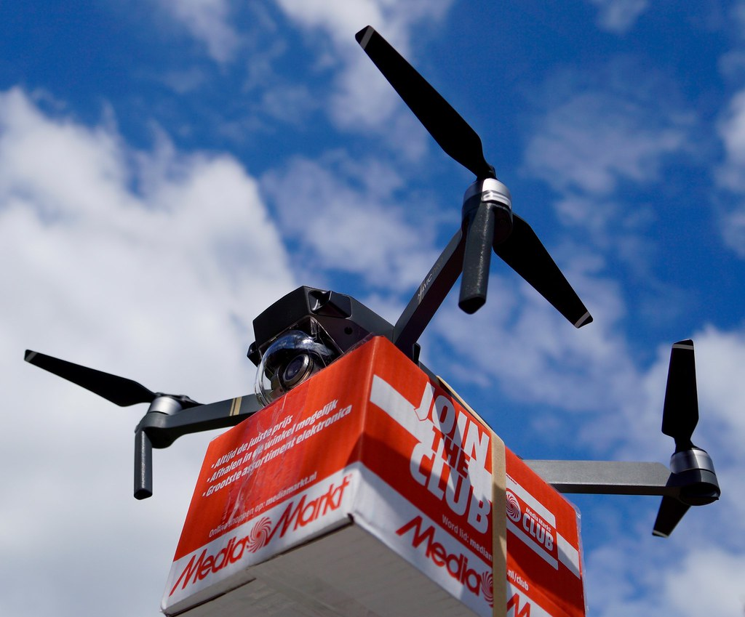
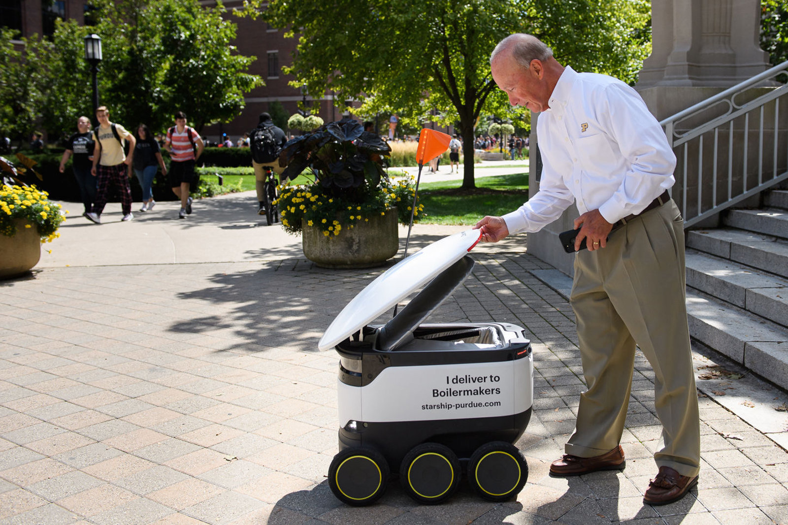
Future Considerations
Notes:
Emily
Our proposal is strongly focused on the pick-up posts as the first step to fulfilling AGM’s vision of the future.
We believe that last-mile delivery efforts like van delivery to the home or delivery drones and robots, are great ideas for implementing in the future.
But implementing the whole system at once without a first proof of concept and expanding the brand awareness would mean we’re investing a lot of capital up front without having a good idea about the return.
This first push to increase brand awareness and set up pick-up posts at well-trafficked BART stations will create a strong foundation for the next parts of AGM’s vision and give us more data to better tune our approach going forward.
Now, Shuo will explain some more suggestions for how to implement AGM’s vision with NoSQL databases.

Slide 11
Using NoSQL DBs
Redis
MongoDB
Neo4j
Key-value store (dictionaries)
In-memory storage (fast look-up)
Data stored as collections of documents
Scalable (replicate data across servers)
Also fast look-up using key
Graph database
Useful for representing graph-like data
Compute distances between nodes via attributes
Notes:
Slide 11
Redis is a type of key-value in-memory store. In-memory means that data is stored on the host’s RAM (Random Access Memory) and it is much faster than performing disk operations.
MongoDB is a non-relational database that offers scalability, high performance, reliability, and flexibility.
Neo4j is graph database and it is useful for computing the distance, time, or cost between nodes.

Slide 12
Applying it to the Business
Redis
MongoDB
Neo4j
Use for caching
Fast look-up of session ID
Fast look-up of delivery address given pick-up point name
Look-up faster than SQL
Look up customer by ID post-login
Get customer’s past orders, favorite pick-up station
Faster than SQL pulling from disparate tables
Calculate shortest paths between points
Store to pick-up point
Between pick-up points
Designed for graph operations
Notes:
Slide 12
Here I will share two business cases. One is Online Transaction Processing and another is Online Analytical Processing. ​
​
First let’s talk about online transaction processing.
When customers log in our website, the web server will create a unique session ID. This section ID is the key for Redis, and the value is the session variables, which is also known as server-side cookies. Session variables are used and updated with every transaction.
In the mid-1990s, companies originally used relational databases to store session data, but it is too slow. And we need that fast, so the key-value in-memory database was invented. As we know, It’s just like give it a session ID, then give me the session cookies. This is very fast in memory. And In addition to that, this session cookies are usually in a small database which is easy to fit into the memory.
(Other business case: stock quotes, multiplayer game player stats, and live weather data)
If we want to look up the customers’ information, the web server can query all customer data from MongoDB using the customer ID. However, if we use relational database, we would have to pull from several relational tables which would be very intensive to join and very slow.
For Neo4j, we have already used extensively for calculating various point to point delivery paths.​ However, SQL database is not built for processing graph queries.​

Slide 13
SQL DBs vs NoSQL DBs
CUSTOMER
CUSTOMER ID
CUSTOMER NAME
CUSTOMER DATE OF BIRTH
CUSTOMER
CUSTOMER ID | CUSTOMER DOB | SALE ID | ADDRESS ID
ORDER
SALE ID | PRODUCT ID | DATE
ADDRESS
ADDRESS ID | LINE 1 | PINCODE
SALES DETAILS
SALE 1
PRODUCT DETAILS
PRODUCT 1
REVIEWS
PRODUCT 2
REVIEWS
BILLING ADDRESS
SHIPPING ADDRESS
SALE 2
…
PRODUCT
PRODUCT ID | PRICE | RATINGS
REVIEWS
PRODUCT ID | RATING | REVIEW
Notes:
Slide 13
Second, let talk about online analytical processing. And I will introduce it by the comparing the SQL with NoSQL database. As shown in the powerpoint, this is a clear comparison between SQL relational database and NoSQL document database.
With NoSQL database, when we perform some analyses, we can create the point of view that best suits our needs. It’s pretty flexible, we can create different POV such as customer POV, product POV, or sales POV. For example, in this case, if we are studying customers, then we can have the customers at the top layer and then have the sales underneath it, and then the products. So in this structure, we can clearly say that here is the customers, their sales, and the products they bought. That might be good for analytics like
How often do they buy stuff​
How much do they spend​
​
Even for same POV, we can create it in several different ways. We can still have customers at top layer, but then we have products underneath it and then sales, in this case, we are able to find what products do the customers like.
If we want to do the same analysis by SQL, it will take a long time to combine lots of tables in relational database.
Therefore, compared with SQL relational database, NoSQL document databases allow us to organize data in ways that are more convenient for analytics. ​

Slide 14
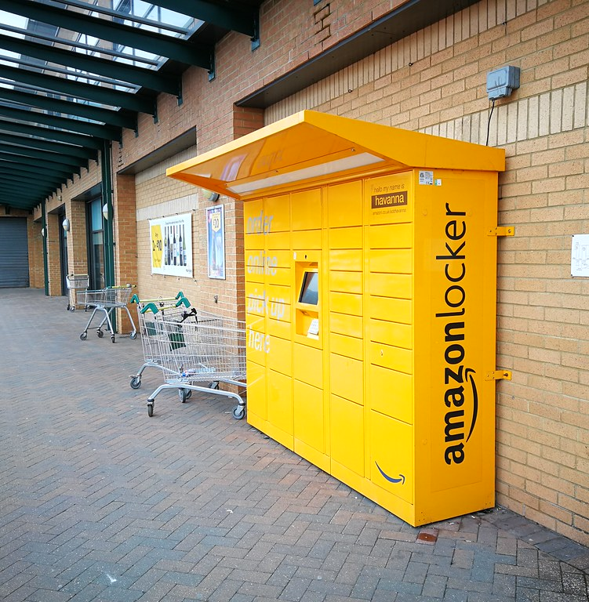
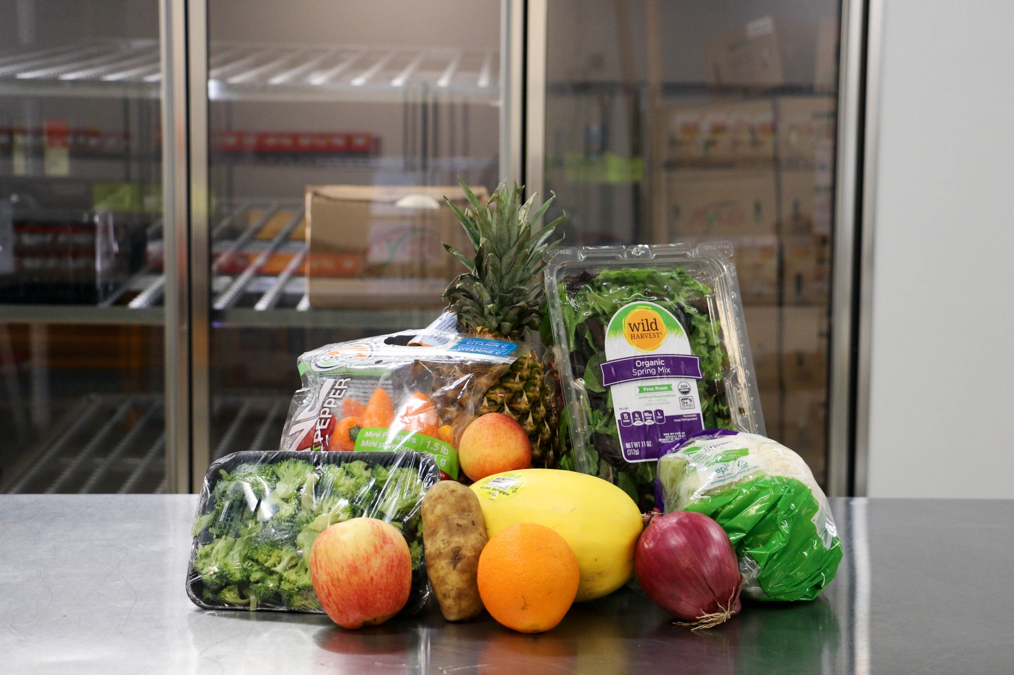
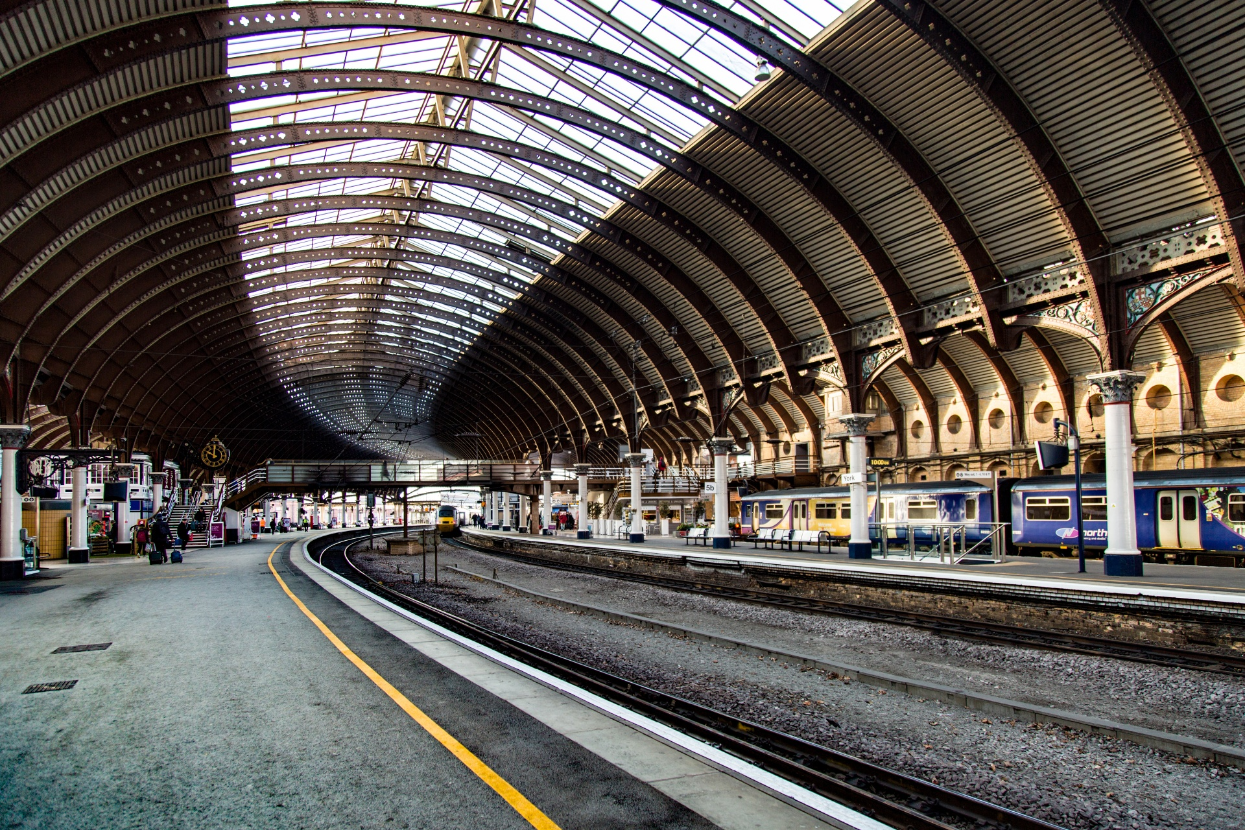
Conclusions
Notes:
Annie
To address our original problem of expanding AGM's brand awareness transbay, we create a proposal to utilize the local transportation system (BART) as a form of meal delivery that will increase community engagement, increase location of local pickup, and decrease time/cost of transportation

